Slide 1


Sukhwinder Singh
Jan 11 2023

Slide 2

Outline
Executive Summary
Introduction
Methodology
Results
Conclusion
Appendix

Slide 3
Executive Summary
In this presentation we will review the finding about the prediction if the SpaceX Falcon 9 first stage will land successfully using different algorithms
Finding in plot graphs will show different correlation of rocket launches and the outcomes of the launches such as success or failure
Steps used
Data collections
Data Wrangling
Data formatting
Data Analysis
Data Visualization
Machine Learning Prediction

Slide 4
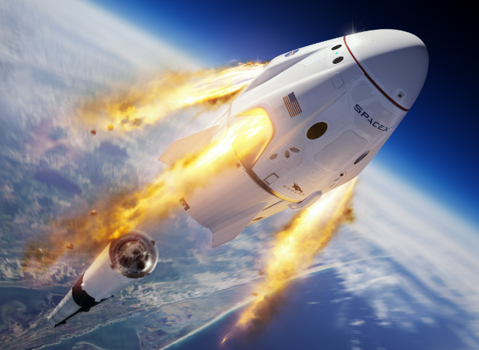
Introduction
SpaceX Falcon 9 rockets cost approx. around $62 million which is cheaper than other provider cost up to $165 million.
Cost difference is due to the fact that SpaceX can land then be re used for again
We need to determine if the first stage will land, which will allow use to determine the cost of the launch
All the information collected will help us with our new company Space Y

Slide 5

Section 1

Slide 6
Methodology
Executive Summary
Data collection methodology:
We used requests such as GET to extract data from SPACEX REST API
Also used web scraping from Wikipedia
Perform data wrangling
Collected the information and then calculating the number of launches and mission after removing all the NaN values from the data
Perform exploratory data analysis (EDA) using visualization and SQL
Used SQL language and Python Libraries to export visual charts
Perform interactive visual analytics using Folium and Plotly Dash
Created interactive dashboards

Slide 7
Data Collection
Data was collected via SPACEX REST API
https://api.spacexdata.com/v4/rockets/ was used to collect data
Within this data collection we cleaned the requested data
Data needed to filter for only falcon 9
Every missing value was replaced with the mean
Data was collected via Webscraping – Wikipedia
Data was obtained from - https://en.wikipedia.org/wiki/List_of_Falcon_9_and_Falcon_Heavy_launches
The website only contained data for Falcon launches

Slide 8
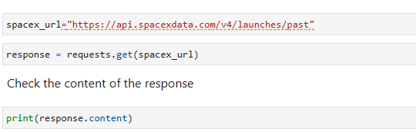
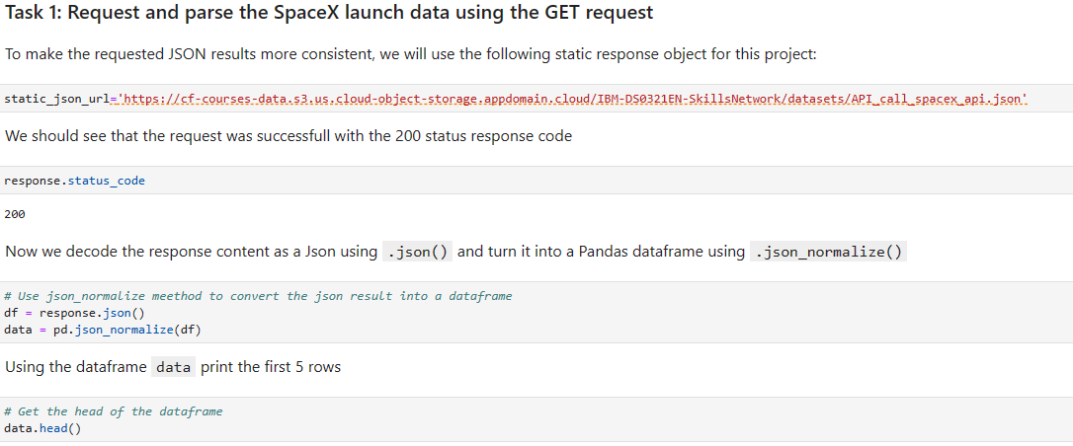
Data Collection – SpaceX API
Task 1 – API calling
Used get command to get the data from the API
Converted the response to .json() which then we used to result into a data frame

Slide 9
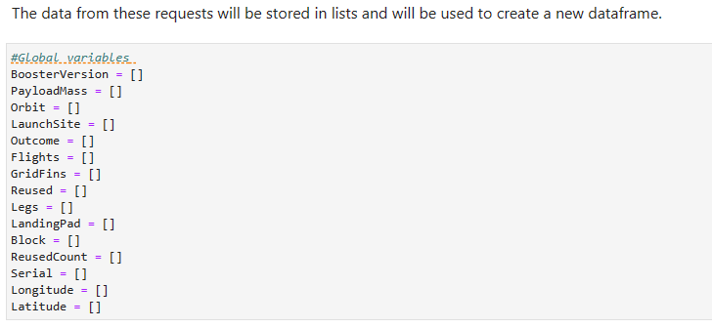
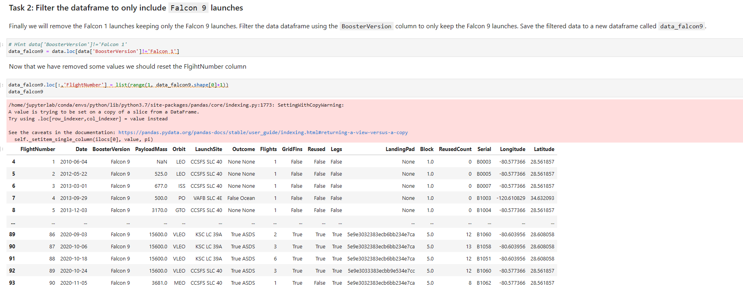
Data Collection – SpaceX API
Task 2 – Creating List and filtering
Created a list for the new dataframe
Stored the values in that dataframe
Filtered the dataframe for only Falcon 9 Launches

Slide 10
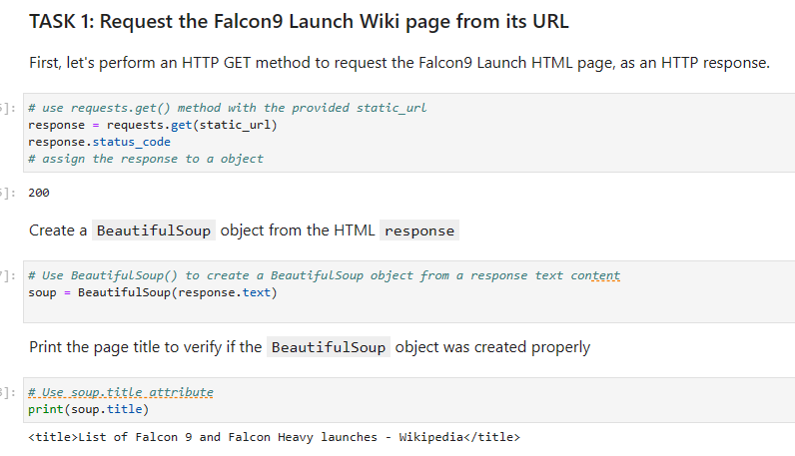
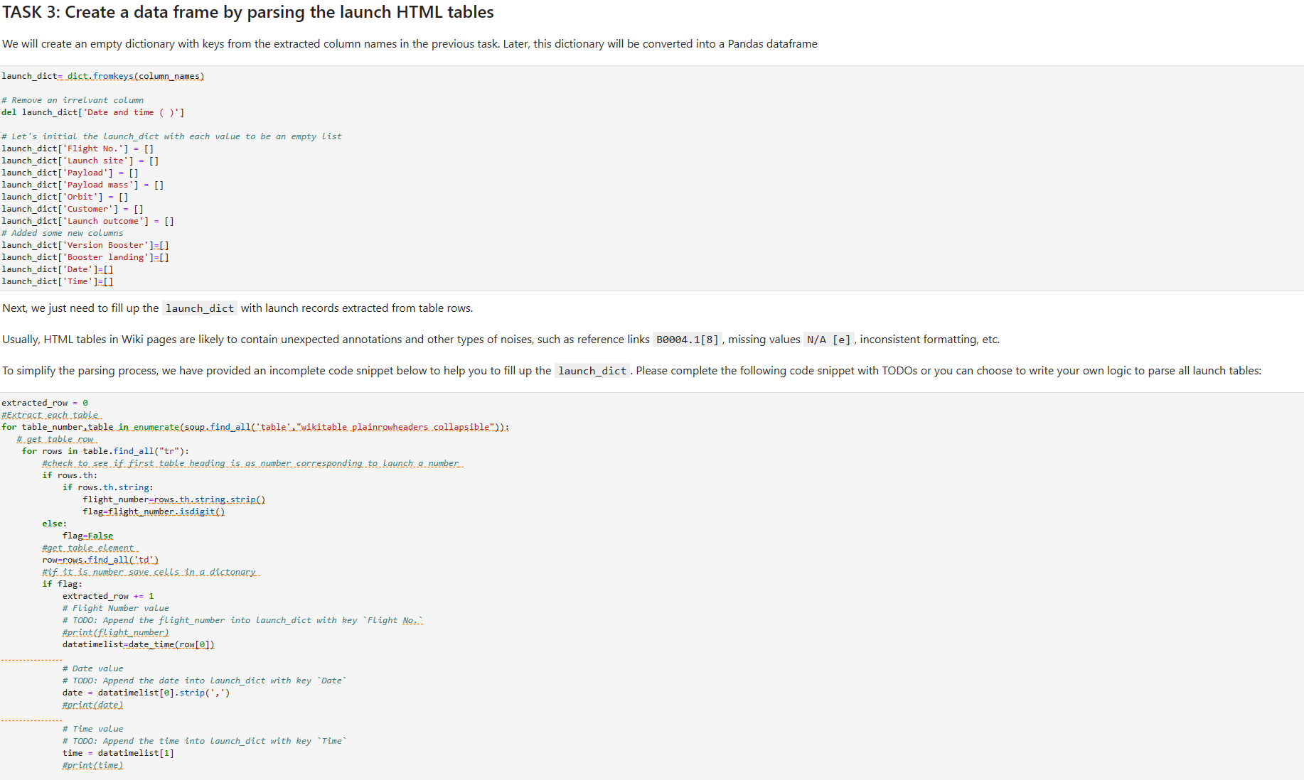
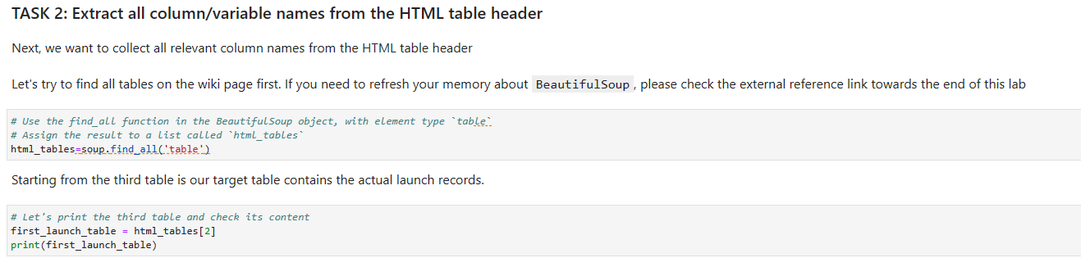
Data Collection – Webscraping
Requested data from wiki page
Created a beautifulsoup object
Extracted all the column headers
Created our own dataframe with these values

Slide 11
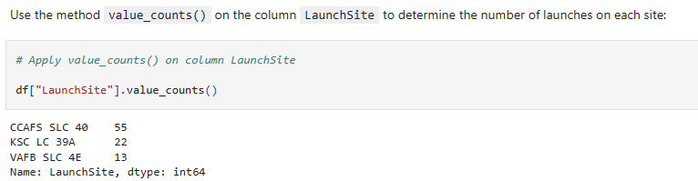
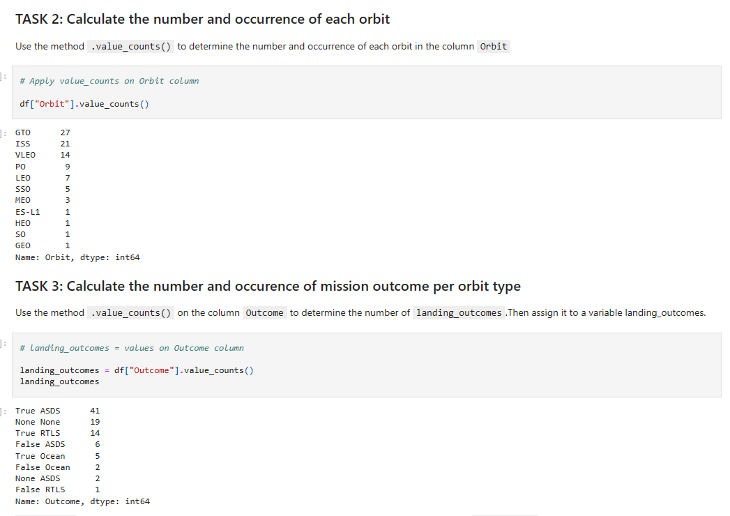
Data Wrangling
SpaceX data contains all the facilities in the Launchsite column
We checked for all the launches in each site
Calculated the number of orbit and the outcome
Created a landing outcome

Slide 12
EDA with Data Visualization
EDA was used to show different types of chart which allowed us to clearly see and compare variables
Charts used
Scatter Plots – ex. Flight Number v Launch site
Bar Charts – ex. Success rate v Orbit type
Line Charts – ex. Success rate v Year

Slide 13
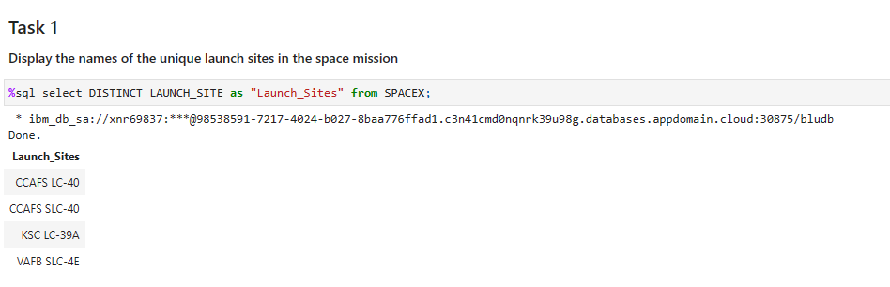
EDA with SQL
Loaded the dataset into the IBM DB2 database
Used python to query for the data
Allowed SQL queries to understand the data

Slide 14

Build an Interactive Map with Folium
Used Folium to visual data on interactive Map
This allowed us to do and see the following on the map
Launch sites
Successful and unsuccessful landings
Distances from certain places to the launch sites

Slide 15

Build a Dashboard with Plotly Dash
Created interactive pie charts and scatterplots
Pie Charts
Showed the successful and unsuccessful launches for all the sites
Pie Charts
Shows the correlation between payload and success for all the launch sites

Slide 16

Predictive Analysis (Classification)
Scikit-learning library was used to create machine learning model
Steps included
Getting the data
Preprocessing the data to standardize our data
Splitting the data
Training and test data
Create machine learning models
Logistic Regression
SVM
Decision Trees
K Nearest neighbor
Evaluate all the scores

Slide 17

Results
EDA – Visualization
EDA – SQL
Interactive Visualizations
Machine learning

Slide 18

Section 2

Slide 19
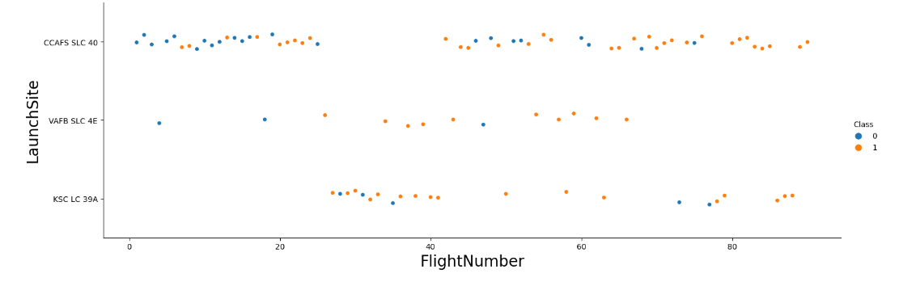
Flight Number vs. Launch Site
Here you can see Flight Numbers v Launch Site
As the number of flights the success rate as increased
Most of all CCAFS SLC 40 early flights were unsuccessful

Slide 20
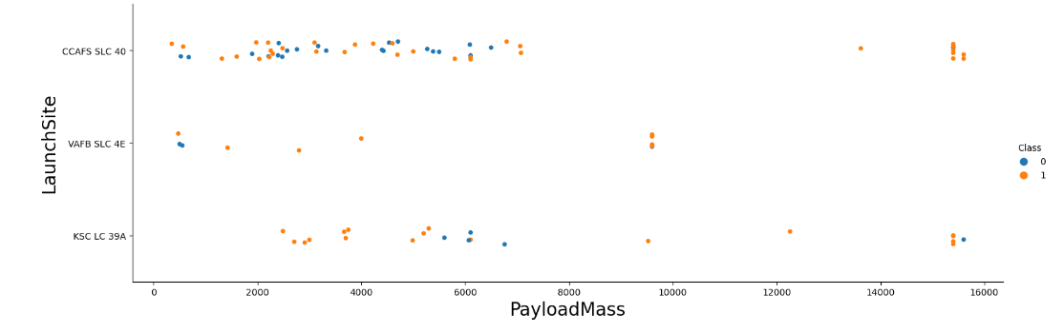
Payload vs. Launch Site
Here you can see Payload v Launch Site
Most the data shows that there is correlation between Launchsites and payloadmass

Slide 21
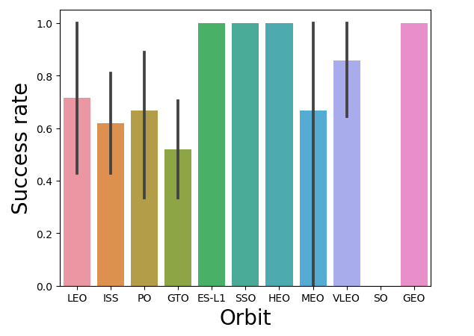
Success Rate vs. Orbit Type
Here you can see Flight Numbers v Launch Site
As we can see Orbits that were 100% successful are
SSO
ES-L1
HEO
GEO
Orbits with 0%
SO

Slide 22
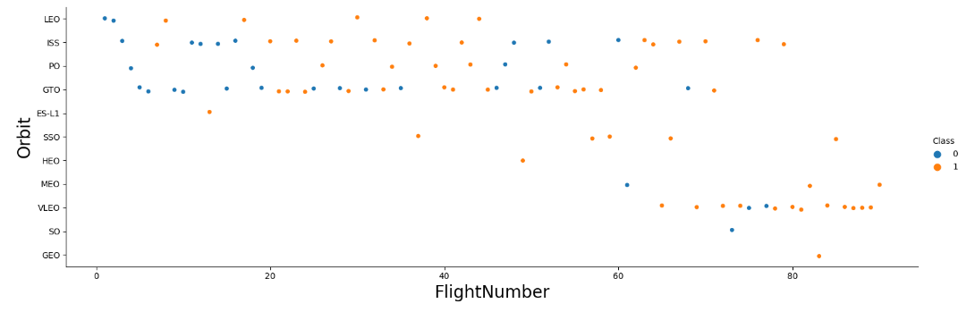
Flight Number vs. Orbit Type
Here you can see Flight Numbers v Launch Site
Here is better visualization of all the 100% orbit success rate have only one launch
SSO is pretty impressive cause it has 5 launches

Slide 23
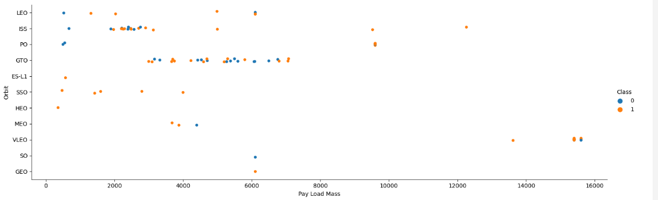
Payload vs. Orbit Type
Here you can see Payload v Orbit Type
Orbit such as ISS, PO have more success with high payloadmass but the sample there is low
GTO is undetermined with the relation of success rate orbit and payloadmass

Slide 24
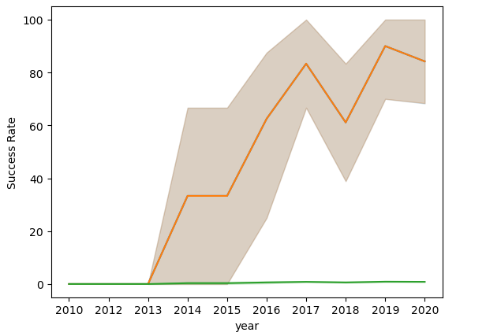
Launch Success Yearly Trend
Here you can see Success Rate v Year
From 2010 to 2013 success was 0
After 2013, success rate started to increase
There was a dip in success 2018

Slide 25
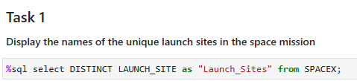
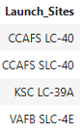
All Launch Site Names
Below are all the launch sites in SpaceX
Only showing unique launch site by using DISTINCT

Slide 26
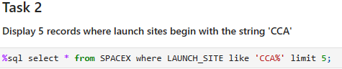
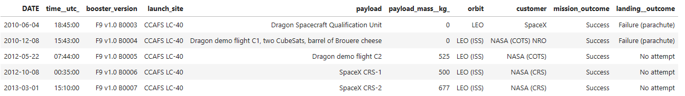
Launch Site Names Begin with 'CCA'
Displaying 5 launch sites that begin with CCA within the dataset.
By using 'CCA%' that matched all the launch sites that start with CCA
Limit 5 – only shows 5 launch sites

Slide 27
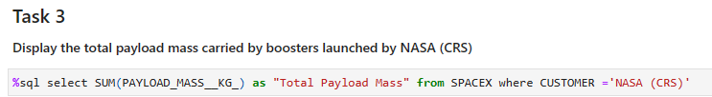
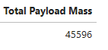
Total Payload Mass
Used the SUM to add all the Payload Mass for NASA (CRS) Customer

Slide 28
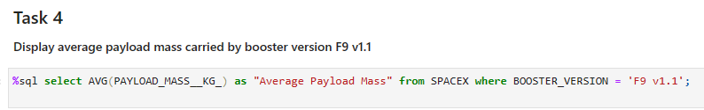
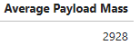
Average Payload Mass by F9 v1.1
Average payloadmass carried by booster version F9 v1.1, used the AVG command with where Booster_Version = 'F9 v1.1'

Slide 29
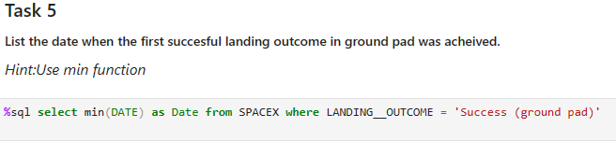
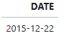
First Successful Ground Landing Date
MIN was used to the find the minimum date – which in this case is 2015-12-22
Where was used to find Success ground pad

Slide 30
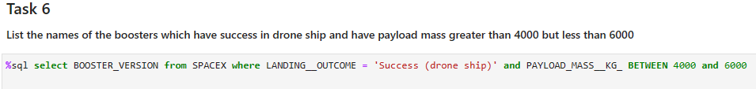
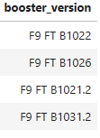
Successful Drone Ship Landing with Payload between 4000 and 6000
Selected the Booster_Version column in the data
Used the where landing outcome was success – drone ship and where the payload was between 4000-6000

Slide 31
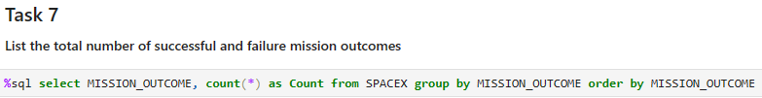
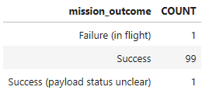
Total Number of Successful and Failure Mission Outcomes
Selected the Mission Outcome column from the database and then grouped them while counting them.

Slide 32
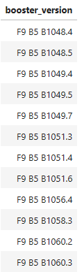
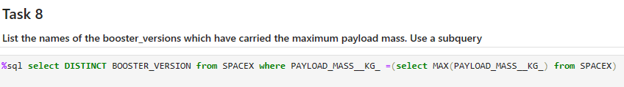
Boosters Carried Maximum Payload
Selected the Booster_Version (unique) where the payload_mass__KG = the max payload

Slide 33
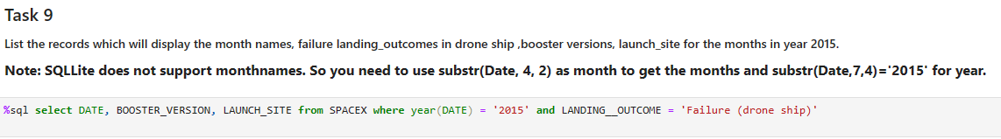
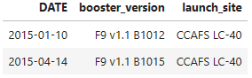
2015 Launch Records
Selected Date, booster_version and launch_site
Used the where command to find date=2015 and the landing_outcome =failure –drone ship

Slide 34
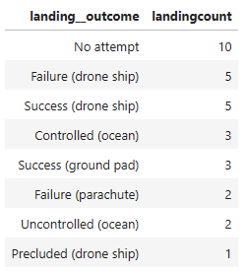
Rank Landing Outcomes Between 2010-06-04 and 2017-03-20
Selected Landing_Outcome, and also counted the landing_outcome
Used where command to find date between 2010-06-04 and 2017-03-20
Grouped the finding and ordered the finding in descending order

Slide 35

Section 3

Slide 36
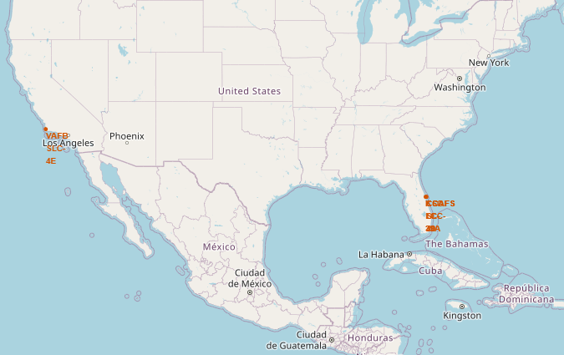
Launch Site locations
Here shows the launch site for Space X
As see they are on both sides of the United states.
3 in the East coast and 1 in the West coast

Slide 37
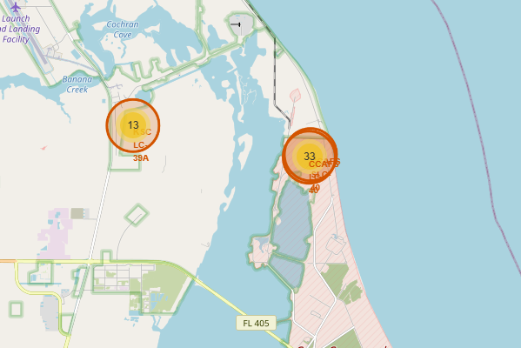
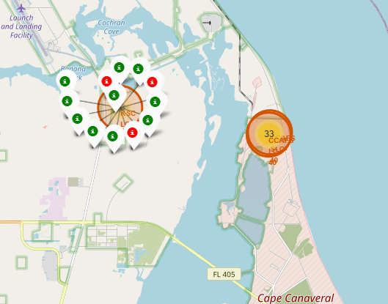
Success and Failed Launches
We can see the launch sites and there success rates. Green shows successful launches and Red shows failed launches.

Slide 38
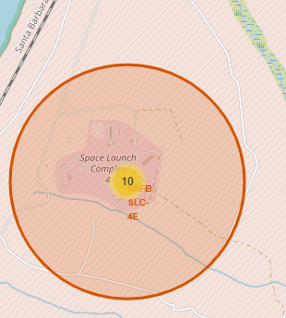
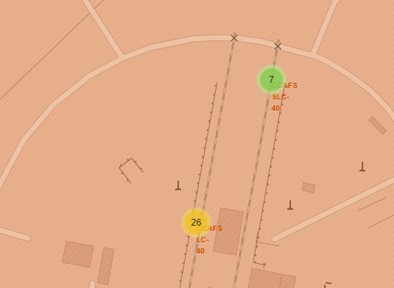
Locations near the launch sites
Here we can see the railways near our launch sites

Slide 39

Section 4

Slide 40
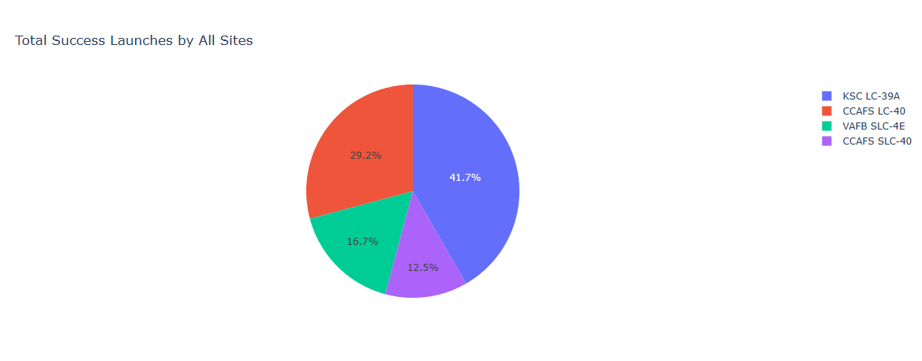
Launch Success Counts for all sites
From here we can see that KSC LC – 39A has the most success launches by all sites.

Slide 41
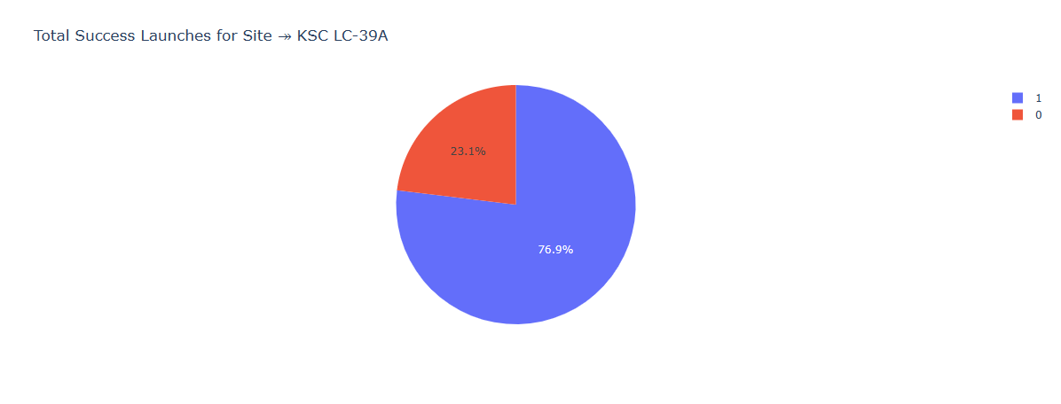
Highest Launching Site Ratio
KSC LC – 39 is the highest launching site and here we can see why. There success rate is at 76.9%

Slide 42
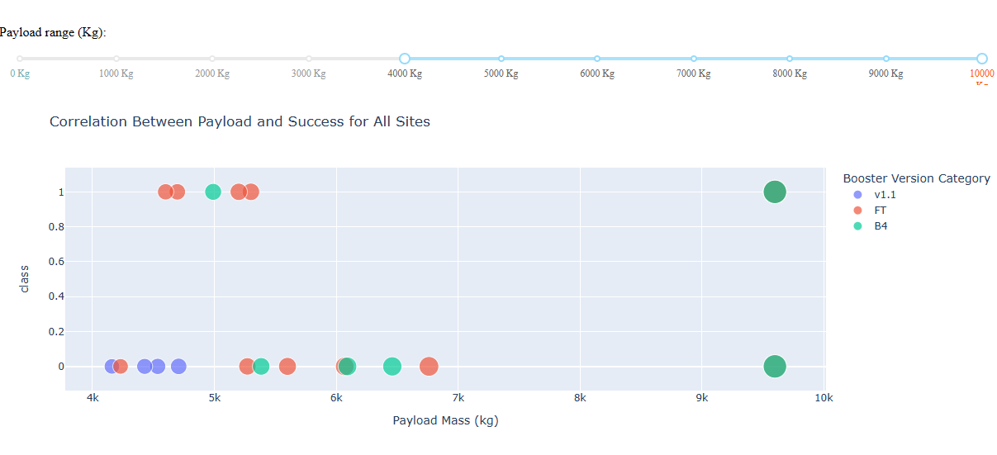
Payload vs. Launch Outcome scatter plot for all sites
We can use different payload and see the outcomes changes for all the different booster version

Slide 43

Section 5

Slide 44
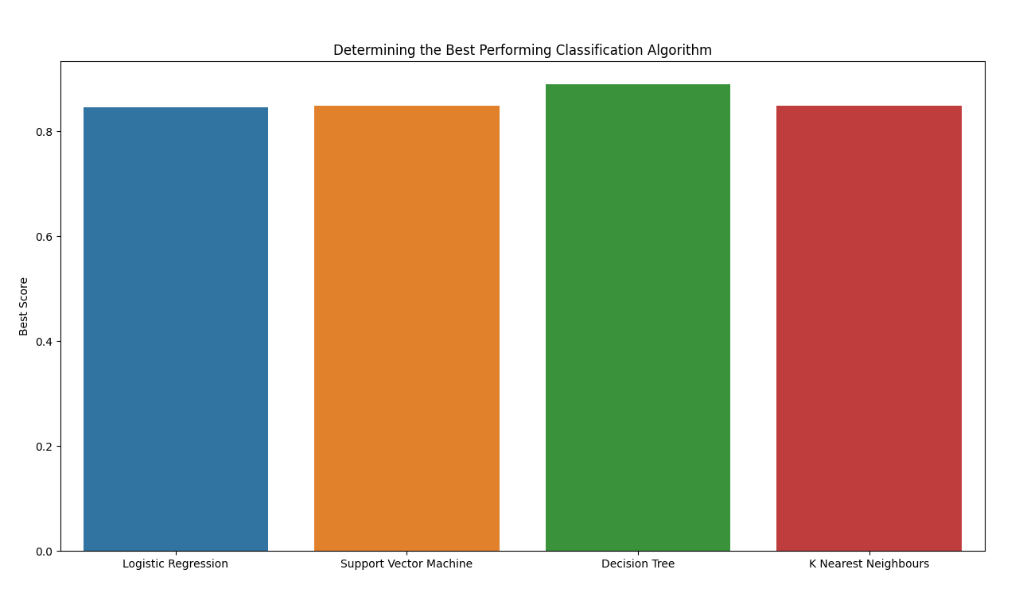
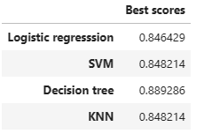
Classification Accuracy
As you can see from these accuracy, that decision tree is the best option. It has the highest classification accuracy

Slide 45
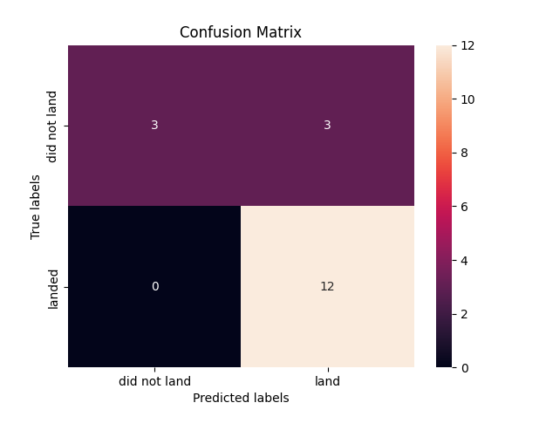
Confusion Matrix
Confusion Matrix explains the following
12 successful landings when true labels is landed
0 when predicted did not land and true labels is landed

Slide 46
Conclusions
2010 – 2013 there were 0 successful landing
After 2013 started the successful pattern
2018 dipped and saw more then usual unsucessful launches
4 100% orbits – ES-L1, GEO, HEO and SSO
Launch site KSC LC-39 most successful launches
As the numbers of flights increased the success rate increased.

Slide 47
Appendix
https://github.com/sukhwinder2392/SpaceX

Slide 48


